Slide 1
Fraud Detection in E-Commerce Transactions
Presented By:
Kshitij, Rohit, Saurabh, Sudhanshu, Aman

Slide 2
Problem Statement
This project addresses the critical issue of fraudulent transactions in the e-commerce sector. The primary goal is to develop a robust fraud detection system that can accurately identify and flag suspicious activities in real-time. By analyzing various transactional attributes, the system aims to minimize financial losses for both customers and businesses, thereby enhancing the overall security and trustworthiness of online platforms. This initiative is crucial in combating the ever-evolving tactics of fraudsters and ensuring a safer online shopping experience.

Slide 3
System Development Approach
System Requirements
Python 3.x
Jupyter Notebook or any Python IDE
Standard libraries: Pandas, NumPy, Matplotlib, Seaborn, Scikit-learn
Library Required to Build the Model
Pandas: For data manipulation and analysis.
NumPy: For numerical operations.
Matplotlib & Seaborn: For data visualization.
Scikit-learn: For implementing machine learning models and evaluation metrics.
Warnings: To handle and filter warnings during execution.

Slide 4
Algorithm & Deployment
Data Loading & Exploration: The dataset is loaded and checked for missing or duplicate values
Exploratory Data Analysis (EDA): Data is visualized to understand distributions and relationships between features using various plots
Data Preprocessing: Categorical features are converted to numerical values, and all features are scaled for consistency
Model Training & Evaluation: The data is split into training and testing sets. Multiple classification models like Logistic Regression, Random Forest, and SVM are trained and evaluated on their performance.
Model Selection & Deployment: The best model is chosen based on evaluation metrics. A function is created to take user input and predict fraud.

Slide 5
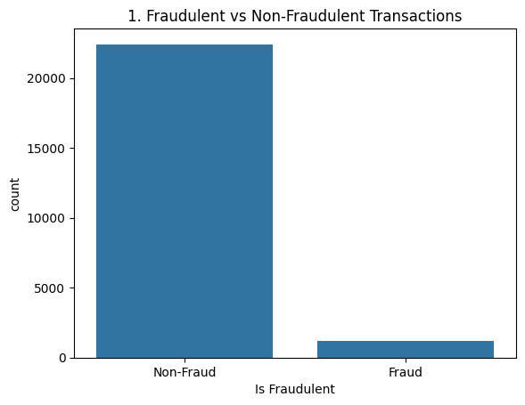
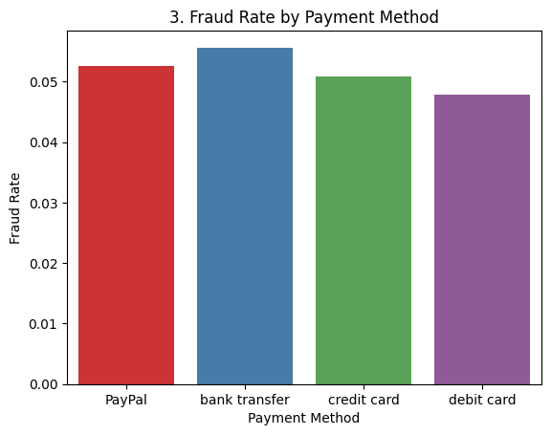
Fraudulent vs Non-Fraudulent Transactions and Payment method

Slide 6
Accuracy rate by different model
Logistic Regression Accuracy: 0.9528242013962344
Random Forest Accuracy: 0.9513433467315422
SVM Accuracy: 0.9521895493970806
KNN Accuracy: 0.9494393907340808
Naive Bayes Accuracy: 0.9420351174106198

Slide 7
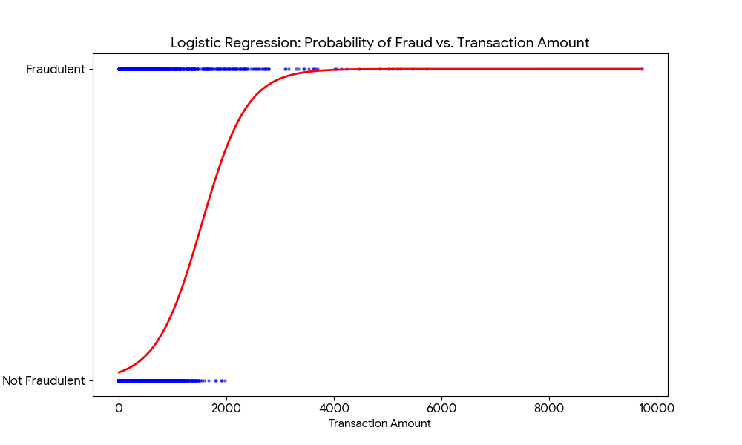
Best model
✅ Best model: Logistic Regression with accuracy 0.952

Slide 8
Thank you

